Slide 1

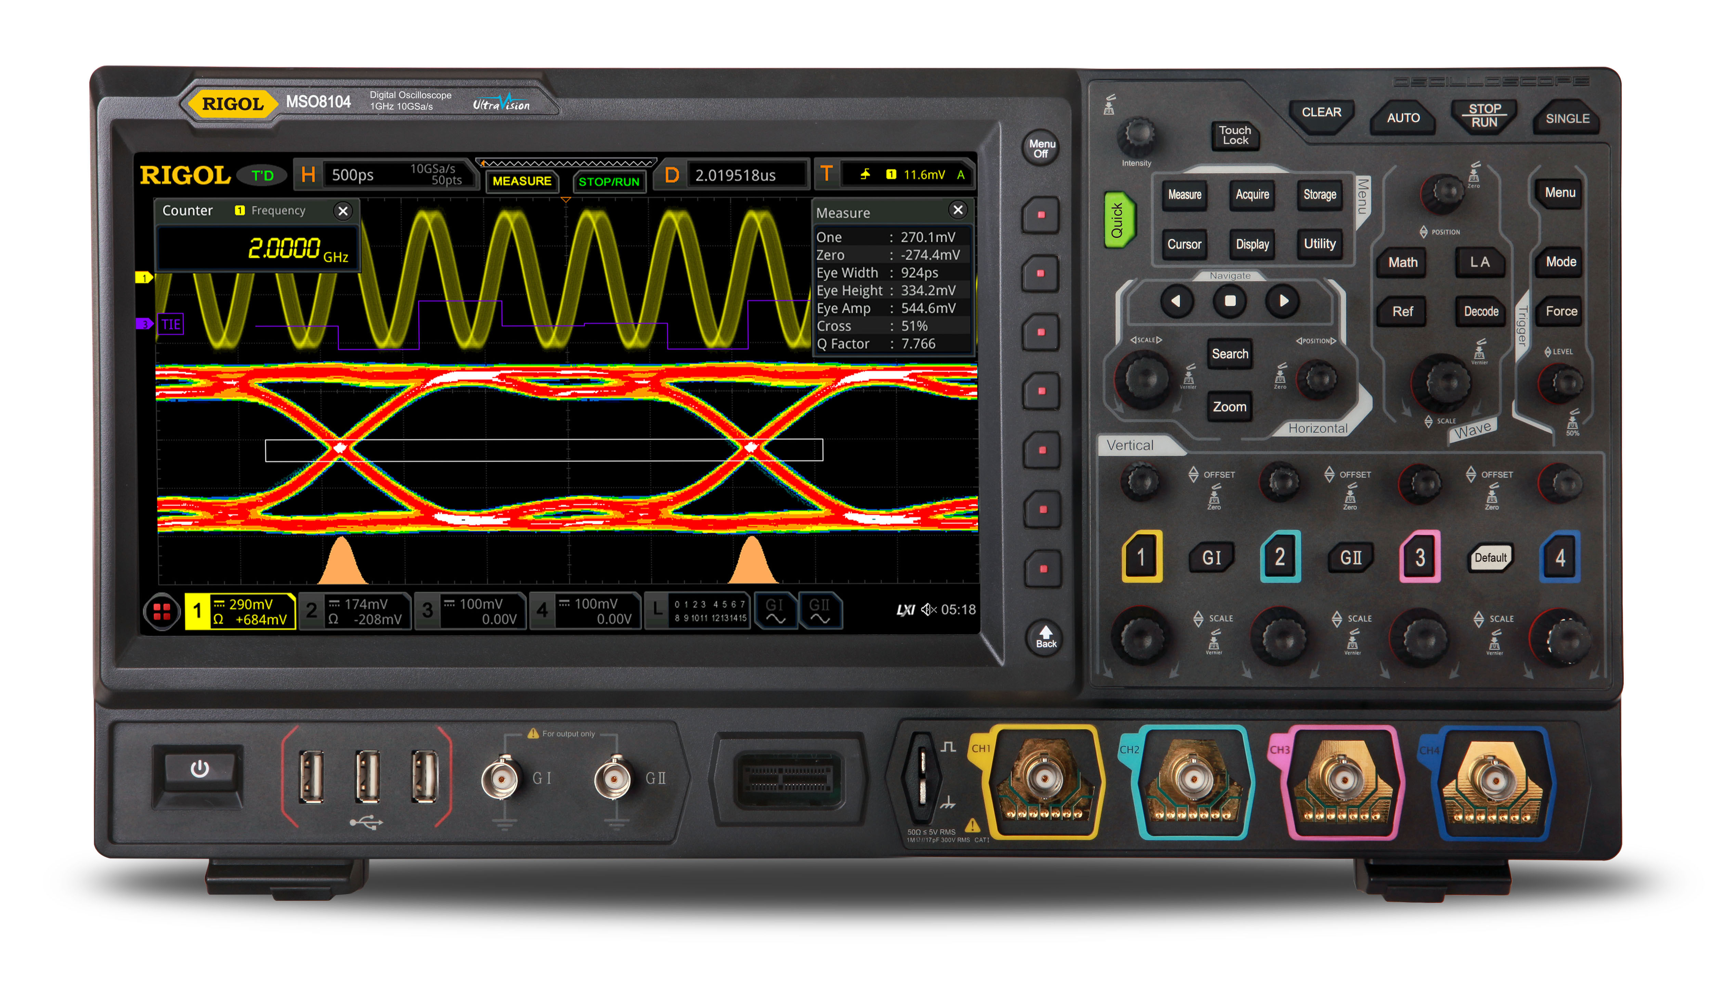

DBSP: A formal model for streaming computation; applications to incremental computations and databases
Mihai Budiu – .com
October 18, 2023
Utah Center for Data Science
University of Utah

Slide 2

If you want to know more
DBSP: Automatic Incremental View Maintenance for Rich Query Languages Mihai Budiu, Tej Chajed, Frank McSherry, Leonid Ryzhyk, Val Tannen VLDB 2023
Best paper award

Slide 3
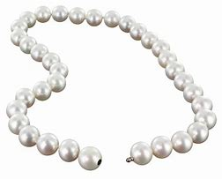
A simple streaming language called DBSP
Inspired by Digital Signal Processing
Four (4) operators
A new definition of incremental computation using DBSP
An algorithm converting an arbitrary DBSP program to an incremental DBSP program
A recipe implementing DB queries in DBSP
2 operators needed for standard SQL
2 for recursive queries

Slide 4

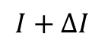
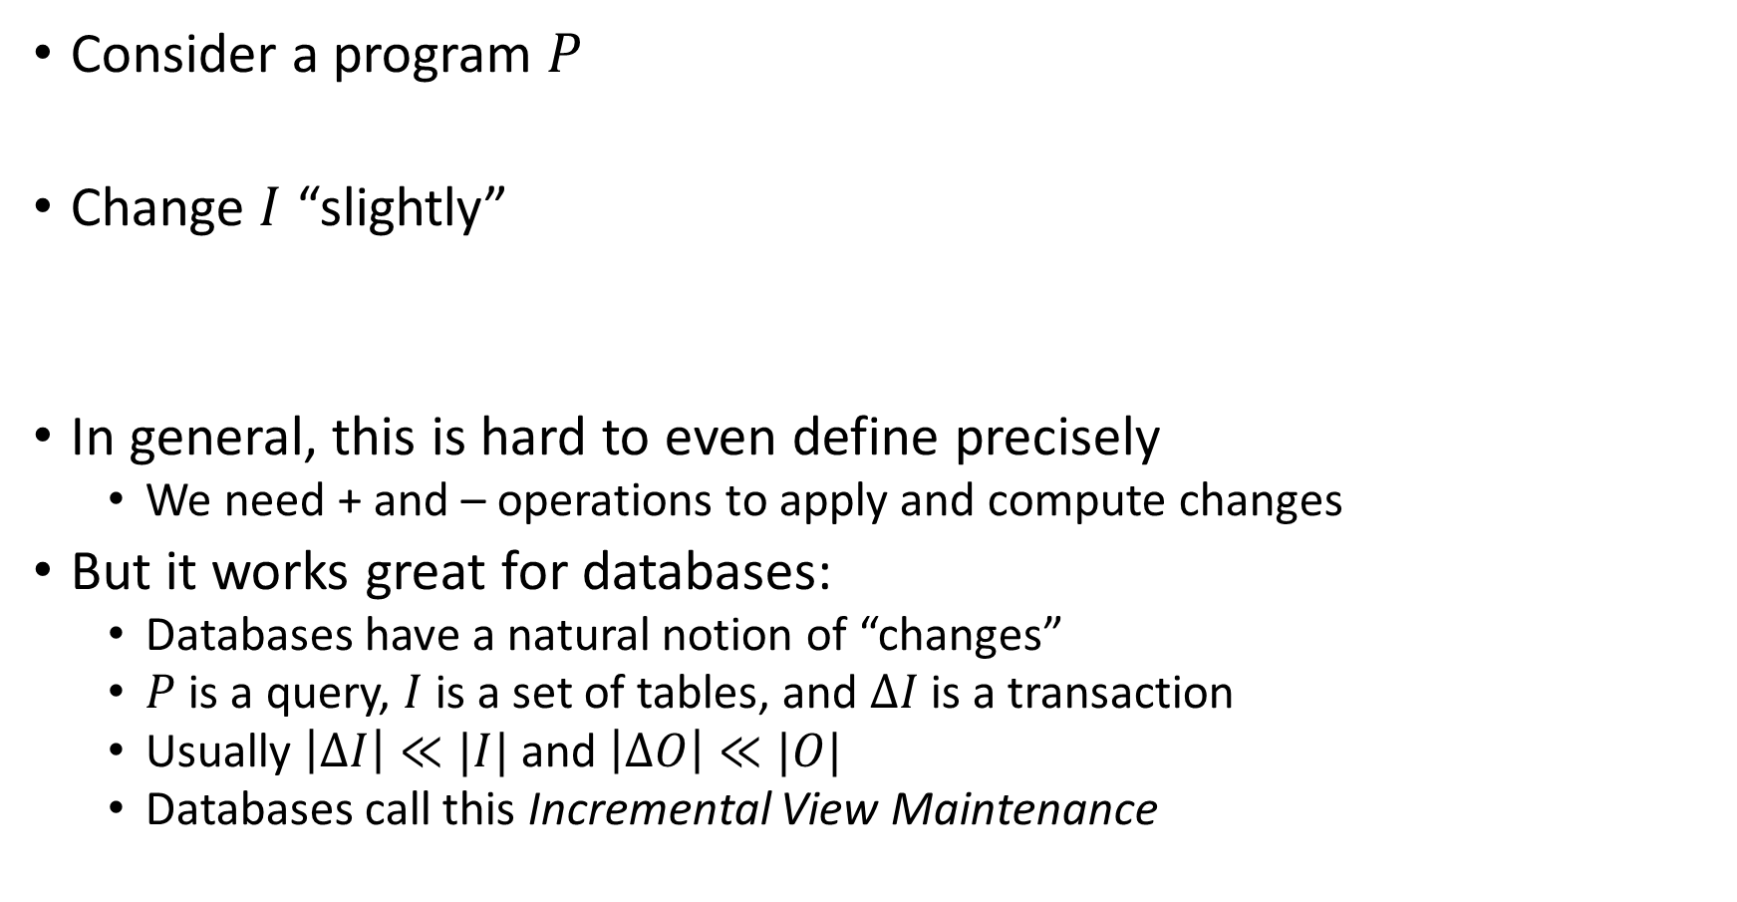
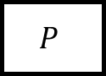
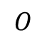
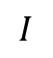
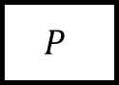
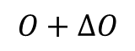
What is incremental computation?
Consider a program $P$
Change $I$ “slightly”
In general, this is hard to even define precisely
We need + and – operations to apply and compute changes
But it works great for databases:
Databases have a natural notion of “changes”
$P$ is a query, $I$ is a set of tables, and $ΔI$ is a transaction
Usually $\left|ΔI\right|≪|I|$ and $\left|ΔO\right|≪|O|$
Databases call this Incremental View Maintenance
$$I$$
$$P$$
$$O$$
reuse
$$I+ΔI$$
$$P$$
$$O+ΔO$$

Slide 5

Outline
Stream computations
Databases as streaming systems
Incremental computation on streams
Optimizing incremental circuits
DB queries in DBSP
Implementation

Slide 6
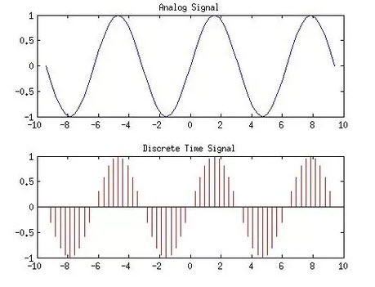
Analog and digital signals
Analog to digital conversion
Digital to analog conversion

Slide 7

Nyquist–Shannon sampling theorem
If a signal contains no frequencies higher than B hertz, it is completely determined by giving its values at a series of points spaced 1/(2B) seconds apart.
Our ears cannot hear more than 20khz
CDs sampling rate is 44.1khz
Analog signal
Analog circuit
Analog signal
A/D
D/A
Digital signal
Program
Digital signal

Slide 8

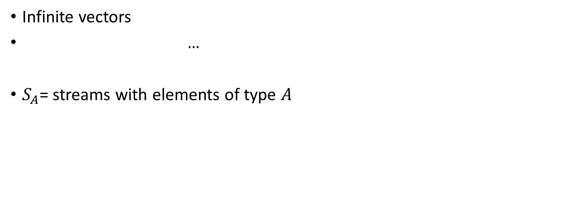
Streams
Infinite vectors
…
$S_{A}$= streams with elements of type $A$
0
1
2
1
0
-1
-2
-1
time

Slide 9
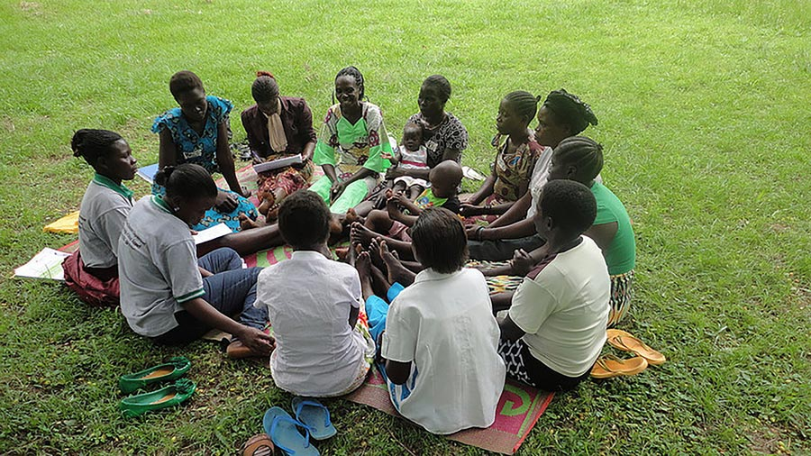
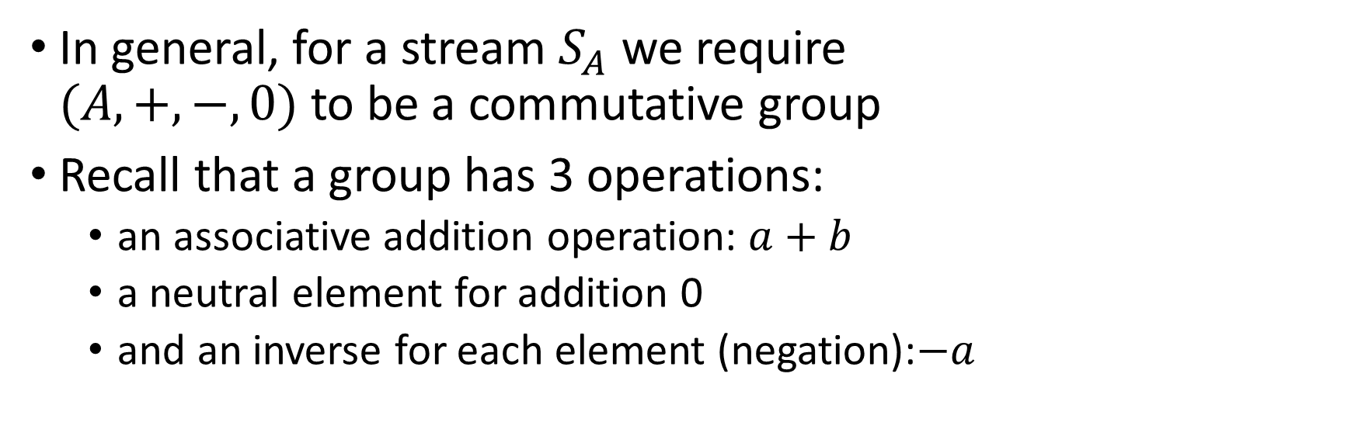
Groups
In general, for a stream $S_{A}$ we require $(A, +, −, 0)$ to be a commutative group
Recall that a group has 3 operations:
an associative addition operation: $a+b$
a neutral element for addition 0
and an inverse for each element (negation):$−a$

Slide 10
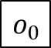
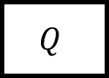
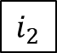
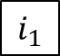
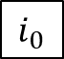
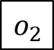
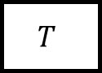
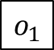
Stream operators
Arrows = streams
boxes = operators
We only use deterministic operators
$$i_{0}$$
$$i_{1}$$
$$i_{2}$$
…
$$Q$$
$$o_{0}$$
$$o_{1}$$
$$o_{2}$$
…
…
$$T$$
…
…

Slide 11
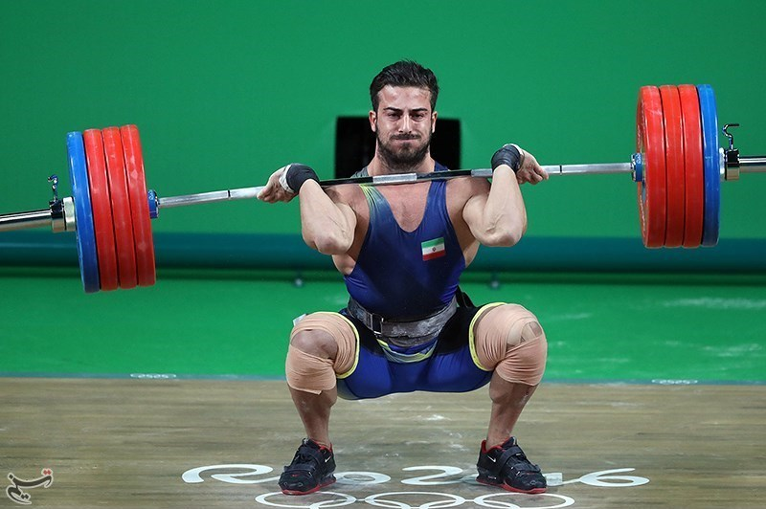
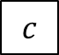
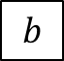
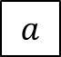
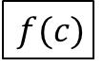
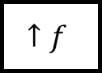
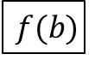
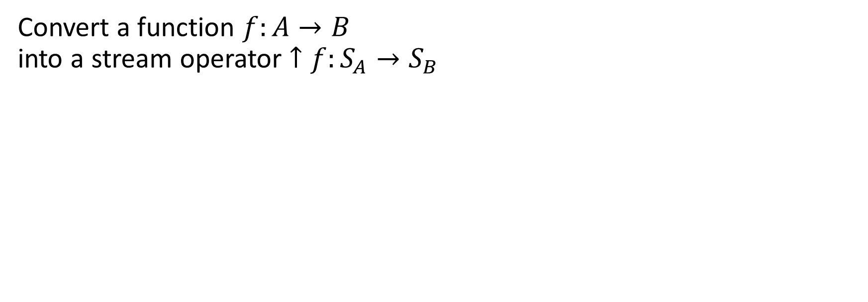
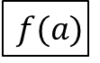
Lifting
Convert a function $f:A→B$ into a stream operator $↑f:S_{A}→S_{B}$
$$a$$
$$b$$
$$c$$
…
$$↑f$$
$$f(a)$$
$$f(b)$$
$$f(c)$$
…

Slide 12
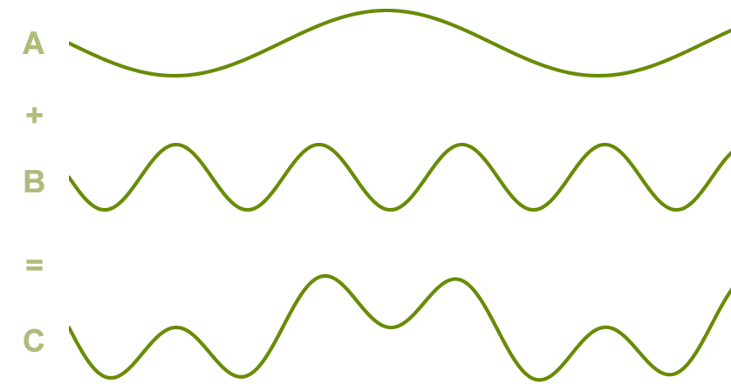
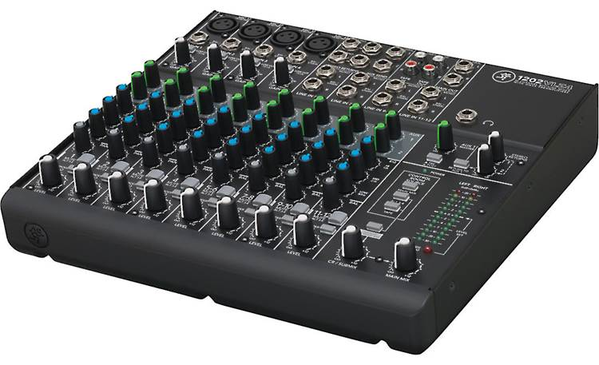
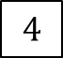
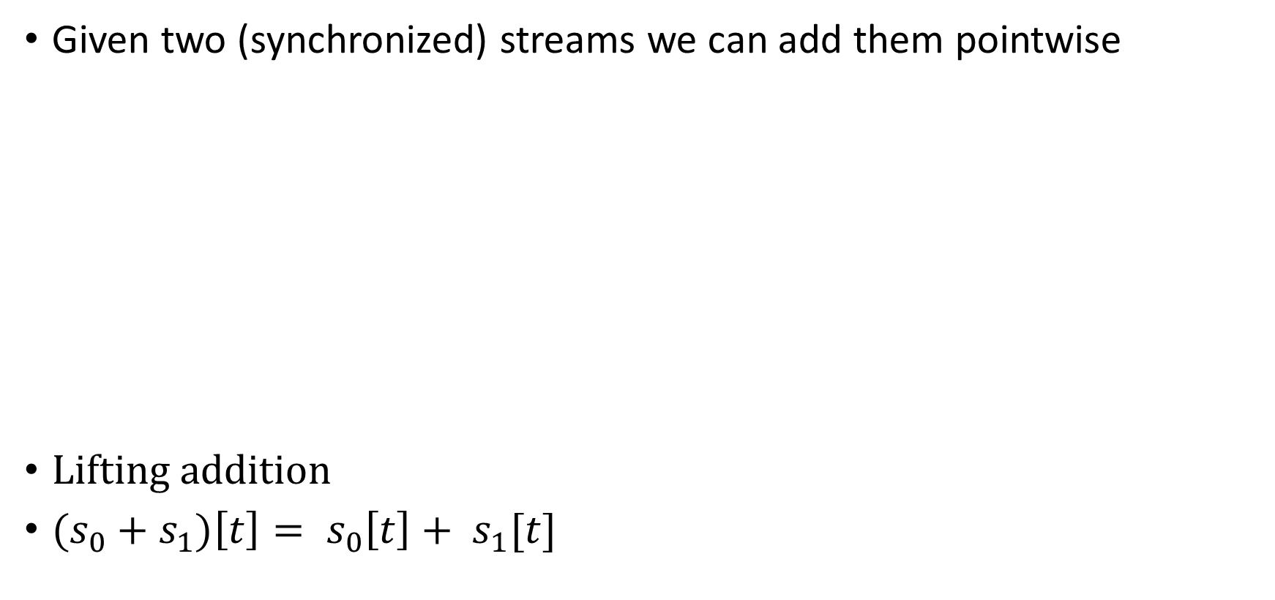


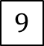

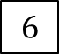

Addition
Given two (synchronized) streams we can add them pointwise
Lifting addition
${(s}_{0} + s_{1})\left[t\right]= s_{0}\left[t\right]+ s_{1}[t]$
$$1$$
$$2$$
$$3$$
…
+
5
7
$$9$$
…
$$4$$
$$5$$
$$6$$
…

Slide 13

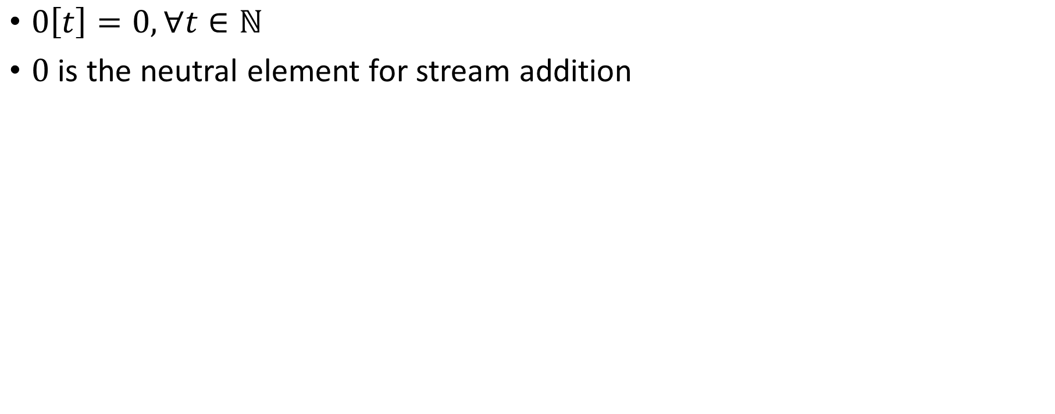
Silence
$0\left[t\right]=0, ∀t∈ℕ$
$0$ is the neutral element for stream addition

Slide 14
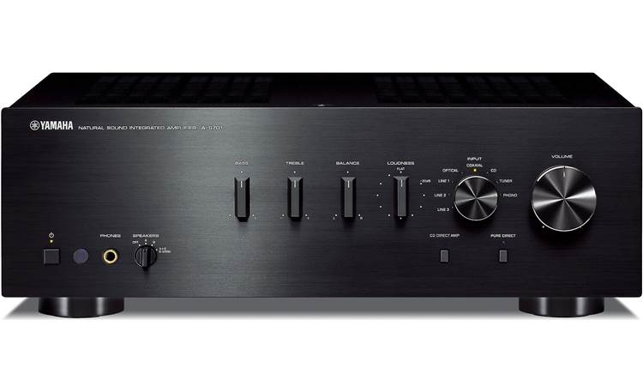
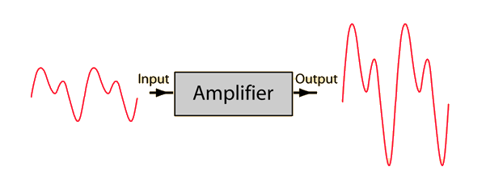
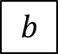
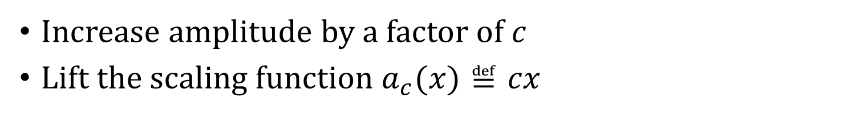
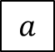
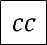
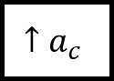
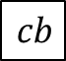
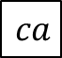
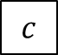
Amplification
Increase amplitude by a factor of $c$
Lift the scaling function $a_{c}(x)≝cx$
$$a$$
$$b$$
$$c$$
…
$$↑a_{c}$$
$$ca$$
$$cb$$
$$cc$$
…

Slide 15
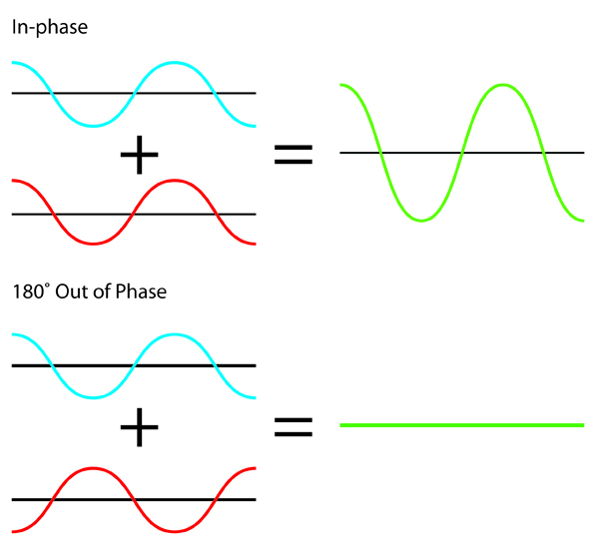
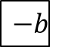
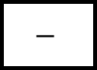






Negation
Lifted unary minus
$−:S_{ℝ}→S_{ℝ}$
$\left(− s\right)\left[t\right]=−(s\left[t\right])$
$$a$$
$$b$$
$$c$$
…
$$−$$
$$−a$$
$$−b$$
$$−c$$
…

Slide 16






Chaining operators into circuits
“Dataflow graphs”
$$i1$$
$$A$$
$$B$$
$$C$$
o
$$i2$$
$$D$$

Slide 17

Noise cancellation
Predict future values (easy for periodic signals)
Generate a negated stream
Add it to original stream
i
+
o
-

Slide 18







Circuit equivalence
Two circuits are equivalent iff they compute the same result given the same inputs
Function composition is associative => these circuits are equivalent:
$$A$$
$$B$$
$$C$$
$$⇔$$
$$A$$
$$B$$
$$C$$

Slide 19










Delay ($z^{−1}$ )
Output is input stream delayed by one step
First value is 0
$$a$$
$$b$$
$$c$$
$$d$$
…
$$z^{−1}$$
$$0$$
$$a$$
$$b$$
$$c$$
…

Slide 20


Time-invariance
A stream operator $T$ is time-invariant if does not “depend on time”
i.e., if you delay the input, you get a delayed output
i.e., these two circuits equivalent:
DBSP only uses time-invariant operators
Example which is not time-invariant: $Q\left(s\right)\left[t\right]= s\left[t\right]+ t mod 2$

Slide 21

Causal operators
“Future cannot influence past”
DBSP operators are causal
Example non-causal operator: play a song in reverse
$$i_{0}$$
$$i_{1}$$
$$i_{2}$$
…
$$Q$$
$$o_{0}$$
$$o_{1}$$
$$o_{2}$$
…

Slide 22











Computing changes (deltas) Differentiation
$$o\left[t\right]=s\left[t\right]–s\left[t−1\right]$$
o
o is the stream of changes of s
$$1$$
$$2$$
$$3$$
$$2$$
…
$$D$$
$$1$$
$$1$$
$$1$$
$$−1$$
…
stream of deltas

Slide 23










Integration
$o[0] =s[0]$
$o[t] =s[t] + o[t−1]$
$o\left[t\right]=s\left[0\right]+s\left[1\right]+ …+s[t]$
o
If s is a stream of changes…
… then o is the original stream
$$1$$
$$1$$
$$1$$
$$−1$$
…
$$I$$
$$1$$
$$2$$
3
$$2$$
…
stream of changes

Slide 24


$D$ and $I$ are inverses
$$Δs$$

Slide 25


Linear operators
A unary stream operator $Q:S_{A}→S_{B}$ is linear if:
$$Q\left(s+t\right)=Q\left(s\right)+Q\left(t\right)$$
$−$, $I$, $D$, $z^{−1}$, amplification are linear

Slide 26

Bilinear operators
A binary operator $×:S_{A}×S_{A}→S_{A}$ is bilinear if it distributes over addition
$$\left(s+t\right)×u=(s×u)+(t×u)$$
$$s×\left(u+v\right)=(s×u)+(s×v)$$
Example: lifted multiplication: $T\left(s,u\right)\left[t\right]=s\left[t\right]⋅u[t]$

Slide 27
Outline
Stream computations
Databases as streaming systems
Incremental computation on streams
Optimizing incremental circuits
DB queries in DBSP
Implementation

Slide 28










All databases are streaming databases!
Consider a database $DB$, a set of tables
A committed transaction is a change to $DB$
The set of linearized transactions define $T,$ a stream of changes to $DB$
$T[k]$is the $k$-th transaction
$DB$ is a stream of database snapshots
$DB[k]$ is the contents of the database after $k$ transactions have been committed
$DB[k] = I(T)[k$]
A database (stream) is the integral of a transaction stream
$$T_{0}$$
$$T_{1}$$
$$T_{2}$$
$$T_{3}$$
…
$$I$$
$${DB}_{0}$$
$${DB}_{1}$$
$${DB}_{2}$$
$${DB}_{3}$$
…

Slide 29












Views are lifted queries
Let $Q$ be a query defining a view $V$, e.g.:
CREATE VIEW V AS SELECT * FROM T WHERE Age >= 10
$V[k]=Q\left(DB[k]\right)$
$V$ is a stream of view snapshots:
$$V= ↑Q(DB)$$
$$↑Q$$
$$V_{0}$$
$$V_{1}$$
$$V_{2}$$
$$V_{3}$$
…
Versions of $V$
Versions of $DB$
$${DB}_{0}$$
$${DB}_{1}$$
$${DB}_{2}$$
$${DB}_{3}$$
…

Slide 30
Outline
Stream computations
Databases as streaming systems
Incremental (DB) computations
Optimizing incremental circuits
DB queries in DBSP
Implementation

Slide 31













Incremental view maintenance of view $V$
$${(↑Q)}^{Δ}$$
$$T_{0}$$
$$T_{1}$$
$$T_{2}$$
$$T_{3}$$
…
$$I$$
$$↑Q$$
D
$$ΔV_{0}$$
$$ΔV_{1}$$
$$ΔV_{2}$$
$$ΔV_{3}$$
…
Changes to $DB$
Changes to $V$
$$V_{0}$$
$$V_{1}$$
$$V_{2}$$
$$V_{3}$$
…
Versions of $V$
Versions of $DB$
$${DB}_{0}$$
$${DB}_{1}$$
$${DB}_{2}$$
$${DB}_{3}$$
…

Slide 32

Incremental view maintenance
${(↑Q)}^{Δ}≝ D∘(↑Q)∘I$
This is our definition of IVM
The standard DB definition does not include the last D
This definition is much better:
It is compositional
Inputs and outputs are both deltas
$${(↑Q)}^{Δ}$$
$$T_{0}$$
$$T_{1}$$
$$T_{2}$$
$$T_{3}$$
…
$$I$$
$$↑Q$$
D
$$ΔV_{0}$$
$$ΔV_{1}$$
$$ΔV_{2}$$
$$ΔV_{3}$$
…
Changes to $DB$
Changes to $V$
$$V_{0}$$
$$V_{1}$$
$$V_{2}$$
$$V_{3}$$
…
Versions of $V$
Versions of $DB$
$${DB}_{0}$$
$${DB}_{1}$$
$${DB}_{2}$$
$${DB}_{3}$$
…

Slide 33



Multiple inputs
This generalizes to operators with multiple inputs or outputs
E.g., for a binary stream operator $T:S_{A_{0}}×S_{A_{1}}→S_{B}$
$$T^{Δ}$$

Slide 34










Incremental queries are streaming systems
$${Δi}_{0}$$
$${Δi}_{1}$$
$${Δi}_{2}$$
$${Δi}_{3}$$
…
$$Q^{Δ}$$
$$Δo_{0}$$
$$Δo_{1}$$
$$Δo_{2}$$
$$Δo_{3}$$
…
state
$Q^{Δ}$ is a streaming system:
it runs forever
it maintains internal state (even if $Q$ is stateless)
the state is stored in the delay operators (inside $I$ and $D$)

Slide 35


Fundamental Equation of Incremental View Maintenance
$$Q^{Δ}=D∘Q∘I$$
As written, $Q^{Δ}$ is expensive to compute
However, we can often optimize the computation significantly
Notice: we don’t need to compute $\frac{dQ(s)}{ds}$

Slide 36
Outline
Stream computations
Databases as streaming systems
Incremental computation on streams
Optimizing incremental circuits
DB queries in DBSP
Implementation

Slide 37
























Linear operators
Theorem: For a linear stream operator $Q$ we have $Q=Q^{Δ}$
Original:
Optimized:
A speedup of $O(\left|DB\right|/|T|)$ !
$$T_{0}$$
$$T_{1}$$
$$T_{2}$$
$$T_{3}$$
…
$$I$$
$$Q$$
D
$$ΔV_{0}$$
$$ΔV_{1}$$
$$ΔV_{2}$$
$$ΔV_{3}$$
…
$${DB}_{0}$$
$${DB}_{1}$$
$${DB}_{2}$$
$${DB}_{3}$$
…
$$T_{0}$$
$$T_{1}$$
$$T_{2}$$
$$T_{3}$$
…
$$Q$$
$$ΔV_{0}$$
$$ΔV_{1}$$
$$ΔV_{2}$$
$$ΔV_{3}$$
…

Slide 38
Example of a linear query
CREATE VIEW V AS SELECT * FROM T WHERE Age >= 10
“Shardable” queries
You don’t need to know what’s in T to compute the changes to V
Most relational queries use linear operators!

Slide 39






The chain rule (structural recursion)
$$(Q_{2}{∘Q_{1})}^{Δ}=Q_{2}^{Δ}∘Q_{1}^{Δ}$$
Proof by pictures:
$$⇔$$
$$⇔$$
$$⇔$$

Slide 40



Bilinear operators
(Lifted) join, intersection, Cartesian product
From distributivity:$Δ\left(A×B\right)=\left(A×ΔB\right)+\left(ΔA×B\right)+\left(ΔA×ΔB\right)$
Speed-up is $O(\frac{\left|A\right|}{\left|ΔA\right|}+\frac{\left|B\right|}{\left|ΔB\right|})$
$$⇔$$

Slide 41


Incremental operators
$(Q_{2}{∘Q_{1})}^{Δ}=Q_{2}^{Δ}∘Q_{1}^{Δ}$
If we know $Q^{Δ}$ for all primitive operations… …then we can incrementalize any query
For all standard primitive DB operations we know efficient incremental versions

Slide 42
Outline
Stream computations
Databases as streaming systems
Incremental computation on streams
Optimizing incremental circuits
DB Queries in DBSP
Implementation

Slide 43
Computing on tables
T
Query result
Name | Age
Mike | 10
John | 12
Amy | 8
Chris | 10
Query
Name | Age
Mike | 10
John | 12
Chris | 10
SELECT * FROM T WHERE Age >= 10

Slide 44

Hold on! This is not well-defined!
The definitions of $I$, $D$ require streams over a commutative group
However, tables (sets, multisets) are not groups
E.g., there is no table negation
Solution:
Generalize tables to obtain a commutative group

Slide 45

$ℤ$-sets (also called $ℤ$-relations)
Each row has an integer weight
The weight can be positive, zero, or negative
Name | Age | Weight
Mike | 10 | 1
John | 12 | 3
Amy | 8 | -1
Chris | 10 | 2
tuples

Slide 46



$ℤ$-sets are yummy!
Can represent both tables and changes to tables
Positive weights = elements added
Negative weights = elements removed
Generalize sets and multisets
Classic DB table = $ℤ$-set where all weights are 1
Form a commutative group (because $ℤ$ is a group)

Slide 47

$ℤ$-set addition
Name | Weight
Mike | 1
John | 3
Amy | -1
Chris | 2
Name | Weight
Mike | -1
Dan | 1
Chris | 1
Name | Weight
Dan | 1
John | 3
Amy | -1
Chris | 3
+
=

Slide 48


The distinct operator
“Converts” a $ℤ$-set into a set
Name | Weight
Dan | 1
John | 3
Amy | -1
Chris | 3
Name | Weight
Dan | 1
John | 1
Chris | 1
$$distinct\left( \right)=$$

Slide 49



Relational algebra using $ℤ$-set operations
Recursively defined on query structure
Many operations require a $distinct$
(But many can be removed)
The other operations are all linear or bilinear

Slide 50

Algorithm for incremental view maintenance
Translate recursively a DB query into a circuit $Q$ on $ℤ$-sets
Lift circuit to compute on streams: $↑Q$
Build incremental version of lifted circuit:
$${(↑Q)}^{Δ}≝D∘↑Q∘I$$
Optimize $Q^{Δ}$ using structural recursion:
$$(Q{∘R)}^{Δ}=Q^{Δ}∘R^{Δ}$$
This algorithm is deterministic. There are no heuristics.

Slide 51

DBSP can also express
Nested collections
Group-by (linear!)
Flatmap (linear!)
Aggregation
Recursive queries (fixed points)
Streaming joins, streaming windows
Relational while queries (“Turing complete queries”)
We don’t have a characterization of the power of DBSP

Slide 52
Outline
Stream computations
Databases as streaming systems
Incremental computation on streams
Optimizing incremental circuits
DB Queries in DBSP
Implementation

Slide 53

Formal verification
Theory was verified using the Lean theorem prover
Work done by Tej Chajed
https://github.com/tchajed/database-stream-processing-theory
First formally-specified and formally-verified theory of incremental view maintenance

Slide 54

DBSP Library
https://crates.io/crates/dbsp
MIT license
Rust framework to describe DBSP circuits
Support for relational algebra, nested relations, aggregates, etc.
Implementation of the basic incremental operators
Multi-core execution
Currently in-memory

Slide 55
SQL to DBSP compiler
https://github.com/feldera/feldera/tree/main/sql-to-dbsp-compiler
MIT license
Generates Rust/native code programs using DBSP as a runtime
Based on Apache Calcite
Passes all 5+ million Sql Logic Test tests

Slide 56

Early-stage start-up to build this software stack
Founded May 2023
Seed fund by Costanoa Ventures
Building the software stack
Core runtime
SQL compiler
Documentation
Fault-tolerance
Scale-out
Cloud service
Connectors to other systems (Kafka, CDC, Snowflake, etc.)
Web user interface

Slide 57
Summary
Streaming systems run forever
A table is the integral of a stream
A transaction is the delta of a database
The right definition of IVM: computing changes to views given changes to tables
IVM systems are streaming systems
Almost any query has an efficient incremental implementation
The algorithm to incrementalize a given query is plan trivial:
Just incrementalize each primitive operator in the query
We built all this stuff as O/S
If you have a streaming or IVM problem, consider trying DBSP/Feldera

Slide 58

stream
DB
IVM
IVM

Slide 59
Extra slides

Slide 60



The cycle rule
$$⇔$$
Allows us to recursively incrementalize circuits with feedback
All our circuits are built from:
Sequential composition
Feedback loops
We get a structural recursion scheme for incrementalizing any circuit

Slide 61
Multiset union (can have duplicates)
SELECT * FROM T1 UNION ALL SELECT * FROM T2
T1
+
V
T2

Slide 62

Set union (no duplicates)
SELECT * FROM T1 UNION SELECT * FROM T2
T1
+
$$distinct$$
V
T2

Slide 63

Set difference
SELECT * FROM T1 EXCEPT SELECT * FROM T2
T1
+
$$distinct$$
V
T2
-
Recall: distinct removes elements with negative weights

Slide 64


Query composition
SELECT … FROM (SELECT … FROM T)
T
$$Q_{1}$$
$$Q_{2}$$
V
Query composition is circuit chaining (function composition).

Slide 65

We have barely begun
Distributed execution
Formal verification
Persistence
Fault-tolerance
Load-balancing
Runtime queries
Cloud service
Integration in existing systems (SQL, Spark, Rust, etc.)
Applications

Slide 66
Set intersection
SELECT * FROM T1 INTERSECT SELECT * FROM T2
O(x) :- T1(x), T2(x).
This is a disguised JOIN. We will see it soon.

Slide 67






Projection
SELECT Age FROM T
In DDlog:
O(age) :- T(_, age).
The weight of $t$ = sum of weights of all tuples that project to $t$
$$π_{C}\left(m\right)\left[t\right]=\sum_{\begin{aligned}x∈m \\ π_{C\left(x\right)}=t\end{aligned}}{m[x]}$$
$$T$$
$${↑π}_{C}$$
$$distinct$$
$$V$$
Name | Age | Weight
Mike | 10 | 1
John | 12 | 3
Amy | 8 | -1
Chris | 10 | 2
Age | Weight
10 | 1+2
12 | 3
8 | -1
SELECT Age

Slide 68
Translating a DDlog rule
Rule head
Rule body
RelationHead :- RelationTerm0, not RelationTerm1.
Head relation = circuit output
Relations in body = circuit inputs
Rule body = circuit contents
Edges in circuit = conjunctions in rule body
Turnstyle = projection
Compiled to
RelationTerm0
proj
RelationHead
RelationTerm1

Slide 69
Selection (filtering)
SELECT * FROM T WHERE predicate
O(t) :- T(t), predicate(t).
Name | Age | Weight
Mike | 10 | 1
John | 12 | 3
Amy | 8 | -1
Chris | 10 | -2
Name | Age | Weight
Mike | 10 | 1
John | 12 | 3
Chris | 10 | -2
WHERE Age >= 10

Slide 70



Selection (filtering)
SELECT * FROM T WHERE predicate
V(t) :- T(t), predicate(t).
$$σ:ℤ\left[T\right]→ℤ[T]$$
$$σ\left(m\right)[t]=\left\{\begin{aligned}m\left[t\right], if predicate(t) \\ 0, otherwise\end{aligned}\right.$$
$$T$$
$$↑σ$$
V
$σ$ keeps all tuples for which the predicate is true.

Slide 71
Cartesian products
V(t1, t2) :- T1(t1), T2(t2).
SELECT T1.*, T2.* FROM T1, T2
Name | Age | Weight
Mike | 10 | 1
John | 10 | 3
Amy | 10 | -1
Chris | 10 | 2
Mike | 12 | 3
John | 12 | 9
Amy | 12 | -3
Chris | 12 | 6
Name | Weight
Mike | 1
John | 3
Amy | -1
Chris | 2
Age | Weight
10 | 1
12 | 3
x
=
Multiply weights.

Slide 72


Cartesian products
V(t1, t2) :- T1(t1), T2(t2).
SELECT T1.*, T1.* FROM T1, T2
$m_{1}∈ℤ\left[T_{1}\right],$ $m_{2}∈ℤ\left[T_{2}\right]$, ($m_{1}×m_{2})\left[\left(t_{1}, t_{2}\right)\right]≝m_{1}\left[t_{1}\right]⋅m_{2}\left[t_{2}\right]$
T1
$$↑×$$
V
T2

Slide 73


(Equi)Joins
SELECT Name, Age FROM T1 JOIN T2 ON T1.Name=T2.Name
O(Name, Age) :- T1(Name, Age), T2(Name, _).
T1
$$↑×$$
$$↑σ$$
V
T2
Cartesian product followed by filtering.

Slide 74




Optimizing distinct
Distinct is idempotent: $distinct∘distinct=distinct$
For many relational queries $Q$ the following holds ($Q$ one of select, project, join, map, flatmap, union, intersection)
For Q in join, product, filter, select we have
$$⇔$$
$$⇔$$

Slide 75



Incremental distinct
$$⇔$$
Work proportional to $|d|!$

Slide 76

Complex Relational Example
CREATE VIEW V AS SELECT DISTINCT a.x, b.y FROM ( SELECT t1.x , t1.id FROM t1 WHERE t1.a > 2 ) a JOIN ( SELECT t2.id , t2.y FROM t2 WHERE t2.s > 5 ) b ON a.id = b.id
Inputs and outputs are collections, not streams

Slide 77



Example: Remove distinct calls
⬄
⬄
⬄

Slide 78


Example: Lift and incrementalize
Inputs and outputs are streams
Inputs and outputs are streams of changes

Slide 79


Example: optimize incremental circuit
Chain rule and linearity
Expand join and distinct

Slide 80

Related work
Incremental View Maintenance
Streaming Databases
Streaming languages
Functional Languages
Category theory
Dataflow machines
Synchronous circuits

Slide 81


Materialized View Update Problem
We essentially cover this whole space
IEEE Data Engineering Bulletin, 1995

Slide 82



The ring of weights ($ℤ)$
The multiplication of $ℤ$ shows up in the join implementation …
… where weights of matching keys are multiplied
That’s why joins are bilinear (because $×$ distributes over $+$)

Slide 83

Additional SQL operations
Map (select)
Group-by (nested relations)
Flatmap
Aggregation
Order-by: not a particularly efficient model in DBSP

Slide 84


map_keys(f)
Generalization of SQL SELECT
Given $f:A→B$ the operator map_keys$\left(f\right):ℤ\left[A\right]→ ℤ[B]$ is: map_keys$\left(f\right)\left(i\right)=\sum_{x∈i}{i\left[x\right]⋅f(x)}$
Apply $f$ to each key and “weigh” the result
map_keys$(f)$is linear for any function $f$
Weight of $x$

Slide 85


Groupings
A grouping maps a key to a $ℤ$-set: $K→ℤ\left[A\right]$
Given a key, return a $ℤ$-set
This structure is $ℤ\left[A\right]\left[K\right]$
This is a mathematical group!
Weight
Key | Z-set
K1
K2
K3

Slide 86

Group-by
Given a type of keys $K$ and a function $k: A→K$, groupby$\left(k\right): ℤ\left[A\right]→ℤ\left[A\right]\left[K\right]$ builds a grouping from a $ℤ$-set
groupby is a linear function!
Each tuple in the input delta will affect only one grouping
So ($↑$groupby)$Δ =$ ($↑$groupby)

Slide 87


flatmap_keys
Given $f:A→ℤ[B]$, define flatmap_keys$\left(f\right):ℤ\left[A\right]→ ℤ[B]$ as: flatmap_keys$\left(f\right)\left(i\right)≝\sum_{x∈i}{i\left[x\right]⋅f(x)}$
flatmap_keys is linear for any $f$!
Substitute$ℤ[B][K]$ for $A$, and id: $ℤ\left[B\right]→ ℤ[B]$ for$f$
flatmap_keys(id):$ℤ\left[B\right]\left[K\right]→ℤ[B]$is the right-inverse of group-by
Weight of $x$

Slide 88

Aggregation
Aggregation functions such as weighted SUM and COUNT are linear functions $ℤ\left[ℝ\right]→ℝ$!
$a_{SUM}(s)=\sum_{x∈s}{x×s\left[x\right]}$
(But not linear as functions $ℤ\left[ℝ\right]→ℤ[ℝ]$!)
SELECT SUM(c) FROM I
makeset converts a $ℝ$scalar into a singleton $ℤ$-set
makeset(5) = $\{ 5↦1 \}$
makeset is not linear, but it is not expensive to incrementalize

Slide 89

Non-linear aggregations
E.g., min, max
… or their generalization, top-K
These are not linear on a group structure (they are linear on a monoid… but can’t handle negation)
Implemented using the “brute force” formula:
$${(↑Q)}^{Δ}= D∘(↑Q)∘I$$
The integral is there to “remember” the full set
Can be built efficiently (log work in $|I|$) using a priority queue

Slide 90
Group-By + Aggregate
The composition of
Group-by
map_weights(aggregate)
map_weights applies a function to each grouping
Not to be confused with map_keys from before
Linear if the aggregate function is linear

Slide 91


Parallelization
Join on two threads
Volcano “exchange” operator (from 2 threads to 3 threads)

Slide 92
Outline
Streaming queries in DBSP

Slide 93

Convolutions
Window-based computation
Window is defined by the input transactions (not by the contents of the data stream)

Slide 94


Streaming joins
$t$ are changes to a table
$s$ is a stream
Table $I(t)$ is joined with every stream value in $s$
$o$ is also a stream

Slide 95


Streaming window queries
$θ$ is a stream of wall-clock values (time)
$s$ is a stream of timestamped data
$W$ window function, filters data in $s$ based on timestamp and time

Slide 96


Alternative window definition
In each transaction
$A$ = what is added
$S$ = what is subtracted from window

Slide 97
Outline
Datalog in DBSP

Slide 98
Datalog rules
Rule head
Rule body
sibling(x, y) :- parent(z, x), parent(z, y).
Head relation = circuit output
Relations in body = circuit inputs
Rule body = circuit contents
Conjunctions in rule body = edges in circuit
Turnstyle = projection
Compiled to
proj
sibling
parent

Slide 99


Negation
Stratified: non-recursive
Implemented as either
Subtraction
Anti-join

Slide 100

Recursive computations
Reach(x, y) :- Edge(x, z), Reach(z, y).
The semantics iterates until convergence
To implement “loops” we introduce two new operators:
$δ_{0}$ (enter)
$∫$(exit)

Slide 101


Creating streams from scalars
$$δ_{0}:A→S_{A}$$
$$δ_{0}\left(a\right)\left[t\right]≝\left\{\begin{aligned}a, t=0 \\ &0, t>0\end{aligned}\right.$$
Linear!
scalar
stream
9
9, 0, 0, 0, 0, 0, …

Slide 102


Creating scalars from streams
Only defined for streams that are zero almost everywhere:
$$∫{ :S}_{A}→A$$
$$∫\left(s\right) ≝ \sum_{t≥0}{s\left[t\right]}$$
Linear!
stream
scalar
1, 2, 3, 0, 0, 0, …
6

Slide 103



Implementing recursion (1)
Start with a recursive query O = R(I, O) where I and O are relations, and R is a query (on $ℤ$-sets)
Implement R as a (non-recursive) circuit $R:$
Lift to compute on streams:

Slide 104

Implementing recursion (2)
(3) Connect recursive output to input using a delay
(4) Bracket as follows:

Slide 105
Typing
Scalars (not streams!)
Streams

Slide 106
Inputs
a,0,0,0,…
a,a,a,a,…
a

Slide 107


Theorem: this circuit computes fixed-point of $R$
Denote by $S\left(x\right)=λx.R(a, x)$, where $a$ is the value of input I
$o\left[0\right]=R\left(a, 0\right)=S(0)$
$o\left[1\right]=R\left(a, o\left[0\right]\right)= S\left(o\left[0\right]\right)=S\left(S\left(0\right)\right)$
$o\left[k\right]=S^{k+1}\left(0\right)$
If $o[k] = o[k+1]$, then $∀i≥0 o\left[k+i\right]=o[k]$
Starting from $k$ all outputs of $D$ are 0
(But computation may never converge)

Slide 108
Two kinds of streams
Streams were used previously to model time-evolution of a system
Now we use streams to model the execution of a loop
The stream values are consecutive values of the variables in the loop body

Slide 109

Example: Transitive closure
reach(x, y) :- edge(x, y).
reach(x, y) :- edge(x, z), reach(z, y).
edge
reach
edge
join(edge, reach)

Slide 110


Semi-naïve evaluation
$$⇔$$
Cycle rule => correctness of semi-naïve Datalog evaluation

Slide 111

Streaming, incremental, recursive queries
So far we have implemented a recursive non-streaming query
To make it incremental we apply the same recipe as before…
… treating the non-streaming query as a black-box

Slide 112






Lifting and loops
A circuit like implements a query $Q$
Use the definition: ${(↑Q)}^{Δ}≝ D∘\left(↑Q\right)∘I$ by treating the entire circuit like a scalar operator!
Theorem: lifting a circuit is the same a lifting every operator
Works even for loops
$$P$$
$$↑( )$$
$$⇔$$

Slide 113

Streaming incremental recursive queries
Non-incremental streaming
recursive query
Incremental streaming
recursive query
Apply chain and cycle rules

Slide 114

Streams of Streams
$S_{A}$ is defined for any group $A$
$S_{A}$ itself is a group
$S_{S_{A}}$ is a group!

Slide 115




Streams of streams
Loop iterations
The math works out fine
Even for higher dimensions
But it becomes less intuitive
In particular, $z^{−1}$and $↑z^{−1}$ are very different
Transactions
Shift right
Shift down

Slide 116
Example: Transitive, reflexive closure
input relation E(h: Node, t: Node)
output relation R(s: Node, t: Node)
R(x, x) : - E (x, _). R(x, x) : - E (_, x). R(x, y) : - E (x, y). R(x, y) : - E (x, z), R(z, y).

Slide 117


Transitive, reflexive closure: circuit
Non-recursive query
Recursive version

Slide 118


Transitive, reflexive closure: incrementalize
Lifted (streaming)
Incrementalized

Slide 119

Transitive, reflexive closure: optimize
Incrementalized
(previous)
Apply chain, cycle
nonlinear

Slide 120




Transitive, reflexive closure: (bi)linearity
$${\left(↑{\left(↑⋈\right)}^{Δ}\right)}^{Δ}$$
$$↑(↑distinc{t)}^{Δ}$$
$${\left(↑{\left(↑distinct\right)}^{Δ}\right)}^{Δ}$$

Slide 121


DSP Filters
Most circuits in DSP are composed of linear, time-invariant blocks
These have some very nice mathematical properties
In particular, their output is fully described by their response to an “impulse” (the stream 1,0,0,0…)
Given their impulse response R and an input signal S, the output is R * S – the convolution of R and S
$I$ is an IIR filter – Infinite Impulse Response (1,1,1,1,…)
$D$ is a FIR filter – Finite Impulse Response (1,-1,0,0,….)
However, many of the computations we will need are not linear
So most of the beautiful DSP theory does not apply

Slide 122


Relation to synchronous digital circuits
Combinational logic (acyclic graphs)
“Instantaneous” propagation
Flip-flops or latches (memory elements)
Clocked elements
Remember value from previous clock
This is our delay element $z^{−1}$
Sequential circuits
Combinational logic
All back-edges must go through a latch
clock
input
Combinational
circuit
output
state

Slide 123
Synchronous circuits ideas
The entire state is stored in latches
State summarizes the entire history of the circuit
State = checkpoint.
Optimizations such as retiming can be used to minimize state
Retiming moves around latches without changing the circuit semantics

Slide 124

DBSP vs Differential Dataflow
DBSP is inspired by DD
https://github.com/TimelyDataflow/differential-dataflow
DBSP is much simpler than DD
DD has the notion of “change” built-in
In DBSP the changes are obtained by using $D$ and $I$
DD is more general
DBSP requires that input changes are streamed in time order
In DD changes can be made at any time, not just in time order

Slide 125



Proof of the cycle rule
$$⇔$$
$$⇔$$

